Slide 1
A Danger-Aware A* Agent for CoinTex
COMP6009 Assignment Part A
Colombo-group-08: Pavithra Solomons (24079123), Ravindu Chandrasekara (24100201), Rashmika Dilshan (20543909)
Notes:
Presenter: Pavithra (about 30 s). Hi, we are Colombo-group-08. Our task was to take the greedy agent that plays CoinTex, find out why it fails, and replace it with a better search method. We built a danger-aware A* agent and tested it against the original greedy agent and a genetic algorithm on all 24 levels.

Slide 2
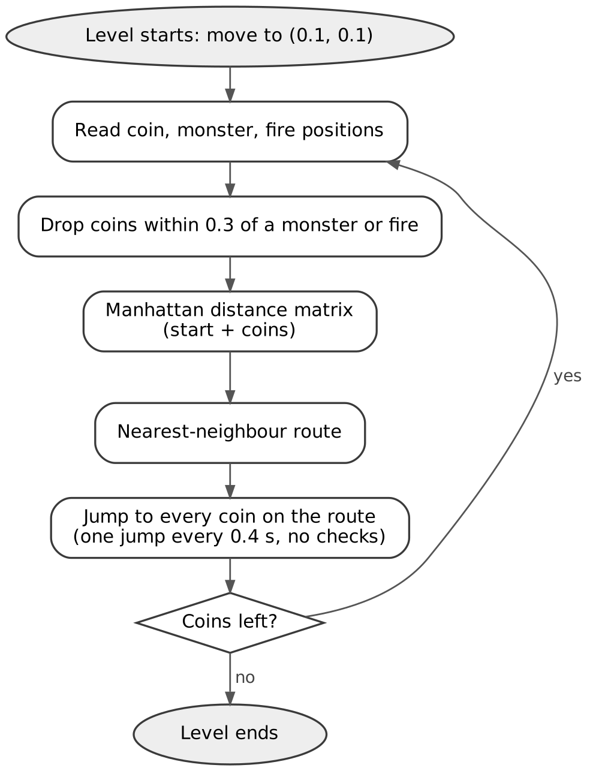
The greedy agent plays with its eyes closed
main_work_greedy.py: nearest coin first, then jump through the whole route without looking
Problem | What happens in the game
Hazards only checked when planning | Jumps between coins can go straight through a monster or fire
Plan made once per route | Monsters keep moving for the whole route (0.4 s per coin)
Start point never updated | Every new plan starts from (0.1, 0.1), not the character
Coin filter bug | Deletes from the list it loops over; the wrong coins get dropped
Thread never stops | After a death two agents drive the next level
Result in the real game: 52 of 59 runs won (88.1%), 7 deaths, 64.6% life left on average.
Notes:
Presenter: Pavithra (about 50 s). The greedy agent measures Manhattan distance to every coin, builds a nearest-neighbour route and then jumps through the whole route, one jump every 0.4 seconds, without checking anything. Monsters and fires are only used to skip coins that are already close to them. So the jumps themselves can pass right through a monster, and the plan goes out of date while the monsters move. We also found bugs: the start point is always the corner, the coin filter deletes from the list it is looping over, and the thread keeps running after the character dies.

Slide 3
Two facts about the game shaped our design
Read from main_work_greedy.py and cointex.kv
0.25 s
20-35
per jump, whatever the distance
frames of contact before the character dies
Time to clear a level depends on the number of jumps, not the distance travelled
Shortening the route, which is what greedy optimises, saves no time
Long jumps are fine as long as nothing is in the way
One life point is lost for every frame touching a monster or fire
At 60 fps that is about a third to half a second of contact
So the agent must know when it will be near a hazard, as well as where
Hit boxes from cointex.kv: monster within 0.075 of the character's centre, fire within 0.05. Coins are collected within 0.05.
Notes:
Presenter: Pavithra (about 40 s). Two details changed how we thought about the problem. First, every jump takes 0.25 seconds no matter how far it goes, so time depends on how many jumps you make, and minimising distance like the greedy agent does saves no time. Second, damage is counted per frame of contact, so a quick pass near a hazard is survivable but lingering is not. That means timing matters as much as position. Ravindu will now explain our agent.

Slide 4
Our agent re-plans every jump with A*
A* from Lecture 3: expand the lowest f(n) = g(n) + h(n); g counts danger, h is an admissible straight-line guess
1 Sense
2 Predict
3 Danger map
4 A* search
5 Safe jump
Positions of the character, coins, monsters and fires; hazard speeds from the last snapshot
Monsters keep their speed, with a margin that grows with time; fires bounce along their path
40 × 40 grid over the screen: very costly inside a predicted hit box, less so nearby
Cheapest path to any coin; step cost = length × (1 + 8 × danger)
Longest straight jump that is clear at the moment the character passes
The jump in step 5 is chosen like this:
Coin reachable safely
Coin not safe, path is
Nothing safe
Jump straight to the coin
Jump to the farthest safe point on the A* path
Escape to the nearby point (or stay) with the most clearance
Repeat every 0.25 s, from wherever the character actually is, until no coins are left
Notes:
Presenter: Ravindu (about 50 s). Our agent runs this loop once per jump. It reads the positions, predicts where each monster and fire will be over the next 0.6 seconds, and turns that into a danger map on a 40 by 40 grid. Then A* finds the cheapest path to any coin, where a step through a dangerous cell costs much more than a safe step. The guess A* uses is the straight-line distance to the nearest coin, which never overestimates, so the path it finds is the cheapest. Each decision takes about 6.7 milliseconds on our laptop.

Slide 5
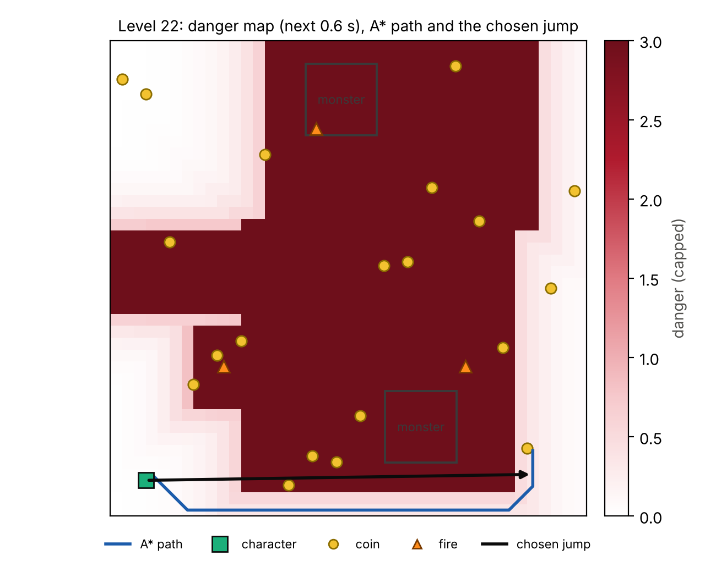
How danger gets into the search
Level 22: predicted danger for the next 0.6 s, the A* path and the jump the agent chose
Dark red cells are where a hazard is predicted to be at some point in the next 0.6 s
A* goes around them (blue line)
The chosen jump (black arrow) cuts the corner: each point on the line is checked against where the hazards will be at the moment the character passes, not where they are now
If nothing is safe, the agent tries 64 nearby points and staying still, and takes the one with most clearance
Notes:
Presenter: Ravindu (about 45 s). This is a real snapshot from level 22. The dark red is the danger map. The blue line is the path A* found around it. But following the path cell by cell would be slow, because every jump costs 0.25 seconds. So the agent looks for the longest straight jump it can make along the path, and checks it in space and time: for every point on the line it works out when the character will be there and where the hazards will be at that moment. Here the jump crosses an area that looks dangerous on the map, but the check shows the hazards will have moved by then.

Slide 6
What is new compared with the greedy agent
Same game, same move command; only the decision making changed
 | Original greedy | Our A* agent
Choosing a coin | Nearest by Manhattan distance, whole route fixed | Cheapest path once danger is counted, chosen again every jump
Monsters and fires | Only skip coins within 0.3 when planning | Predicted 0.6 s ahead and built into every cell's cost
Moving | Straight jumps with no checks | Only jumps that are clear when the character passes
Re-planning | After the whole route | Every 0.25 s
Planning starts from | Always (0.1, 0.1) | The character's real position
In danger | No reaction | Escape move with the most clearance
Search | Nearest-neighbour heuristic | Multi-goal A* with a guess that never overestimates
To keep the test fair, the greedy logic is copied unchanged and every agent moves through the game's own start_char_animation.
Notes:
Presenter: Ravindu (about 35 s). This table sums up what is new. The key differences are that hazards are part of the cost of every cell instead of just a filter on coins, the agent re-plans every jump from where it actually is, and it only makes jumps that are safe at the time it makes them. Rashmika will show the results.

Slide 7
Results: 360 episodes in the real game
3 agents × 24 levels × 5 runs, random coin layout every run, 60 s limit
120/120
52/59
99/120
runs won by A*
runs won by greedy
runs won by the GA
 | Greedy | GA | A* (ours)
Levels completed (3+ wins of 5) | 12 / 24 | 21 / 24 | 24 / 24
Mean time on the 12 levels all agents won (s) | 5.39 | 10.85 | 4.41
Life left (%) | 64.6 | 57.2 | 99.7
Deaths | 7 | 21 | 0
RACR: coins per second × life left | 1.60 | 0.81 | 3.10
RACR is our extra metric: it rewards being fast and unhurt in one number, and still gives credit for coins collected before a death.
Notes:
Presenter: Rashmika (about 50 s). We ran every agent 5 times on every level, 360 episodes in total in the real game. Our A* agent won 120 of 120 runs, greedy won 52 and the GA won 99. To compare time fairly we only used levels that all three agents won at least once, and there A* averaged 4.41 seconds, against 5.39 for greedy and 10.85 for the GA. We also proposed a new metric, RACR, which multiplies the coin collection rate by the life left, so it rewards speed and safety together.

Slide 8
Level by level
Success rate on each level, 5 runs per agent
Greedy fails most on levels 7, 8 and 15 and the GA on levels 13, 18, 21 and 24; every one of their failures was a death. A* won 120 of 120 runs.
Notes:
Presenter: Rashmika (about 40 s). This chart shows success on each level. Grey is greedy, dark grey is the GA and red is our agent. Greedy loses most on levels 7, 8 and 15, and the GA on levels 18, 21 and 24. Every one of their failures was a death: their jumps cross hazards because they never check the path. Our agent won 120 out of 120 runs.

Slide 9
Faster as well as safer
Mean time to collect all coins on each level, successful runs only
A*: 4.41 s on the 12 levels all agents won
Greedy: 5.39 s, GA: 10.85 s
A* hit a hazard for 0.1 frames per run; greedy 9.3, GA 12.3
Part of the speed-up is rhythm: A* moves every 0.25 s, greedy waits 0.4 s per jump as written
Notes:
Presenter: Rashmika (about 40 s). Our agent is also faster. On the levels every agent could win, it averaged 4.41 seconds against 5.39 for greedy and 10.85 for the GA. To be fair, part of this comes from the original greedy code waiting 0.4 seconds after every jump, which we kept as given. The GA is slow because it always chases the first coin in the list and needs about 33 jumps per level. Our agent stays safe while doing this, with almost no hazard contact.

Slide 10
Limitations and what we would do next
Proposed, not implemented
Idea | Why it should help
Hybrid GA + A* | GA evolves the order of the coins (a permutation); A* plans each safe leg and its path costs become the GA's fitness. Fixes stranded coins on 18-25 coin levels
GA to tune A* | Our danger weight, margins and look-ahead were set by hand; a GA could search them per level type
Markov model of monsters | Lecture 8: a belief over where each monster is heading, updated every frame, gives hit probabilities per cell
Expectimax look-ahead | Lecture 6: monsters are random, not adversaries, so plan for the average case over the next few jumps
Limitations: one laptop, 5 runs per level (a level's rate moves in 20% steps), A* settings tuned in our simulator, and the GA is the tutorial GA, not one tuned for this game.
Notes:
Presenter: Rashmika, then Pavithra to close (about 45 s). The main idea we would try next is a hybrid. The GA would decide the order of the coins, and A* would plan the safe path between them, with the A* path costs used as the GA's fitness. That keeps the safety of A* and fixes the cases where our agent leaves one coin stranded far away. We would also use a GA to tune our settings, which we picked by hand. Our main limitations are that everything ran on one laptop, with 5 runs per level. Thank you, we are happy to take questions.

